Slide 1
Movie Database
Ivan Aguirre, minu khosla, shweta Kalavar

Slide 2
Data Sources
For this project we used the “Movie Dataset” which was from https://www.kaggle.com/rounakbanik/the-movies-dataset
The Movie Dataset consisted of the following csv files:
movies_metadata.csv: Contains information on 45,000 movies featured in the Full MovieLens dataset. Features include title, status, length, genres, rating, popularity, budget, revenue, release dates, languages, production countries and companies.
credits.csv: Contains Cast and Crew Information for all movies
links.csv: Contains IMDB IDs of all movies featured in the ratings.csv file (About 45,000 movies).
ratings.csv: Contains ratings from users.

Slide 3
Extract
The Movies Dataset contained large csv files containing about 45k records
We used Panda’s to extract the csv files into Data Frames
Once the files were in the Data Frames, we analyzed the data and quickly realized that the data would need a lot of transformation and cleanup.
The dataset was very large and there were columns that contained dictionaries, string data in form of list of dictionaries, large text and alpha-numeric fields etc…

Slide 4
Transformation
Movies.csv
Created a pandas dataframe
Within the dataframe selected only the relevant columns and discard non-relevant columns
Renamed the columns so that they were more meaningful
Created a new empty dataframe to store only 10k records from 45k records
Cleaned up the columns that had data values stored in form of string that looked like list of dictionaries, large text and alpha-numeric values
Removed the duplicate and null values
Created a new dataframe to hold 10000 records only.
Eventually the new dataframe was stored into a csv file

Slide 5
Production Dataframe
Production companies and production countries columns were cleaned. These had string data in the form of list of dictionaries. The relevant data was hidden in those dictionaries.
Eventually a new dataframe was created to hold 10000 records and stored into a csv file.
Credits.csv
Cleaned cast and crew columns having cluttered data in it in the form list of dictionaries.
Fetched only relevant information like actors, director and producer.
Links.csv
Fetched and cleaned only relevant columns like imdb_id and movied_id
Ratings.csv
Fetched and cleaned only relevant columns .

Slide 6
Loading
We used PgAdmin to design the tables.
We created 5 tables in the database listed below:
Movie
Links
Production
Credits
Rating
Using Panda’s, we made a connection to the Postgres Database and inserted the cleaned data into the above tables
Finally, we used Panda’s to validate the data within the tables in the Database

Slide 7
Query the Database
Join all the tables based on common column.
Used inner join
Fetch relevant columns in the query from all the joined tables

Slide 8
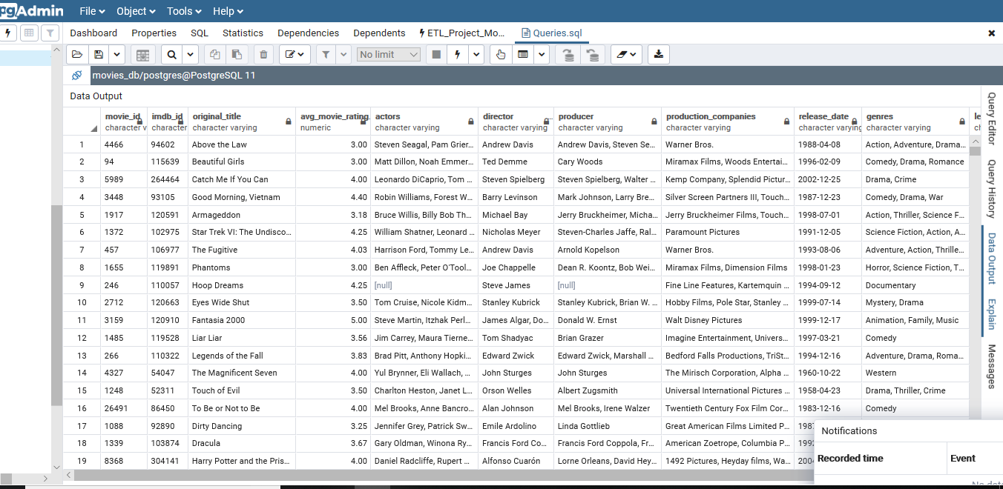

Slide 9
ThankYou.

